Slide 1
Developing transitions
@GregRixASC
www.gregrix.uk
Greg Rix Bsc (Hons), Natural Sciences (Open); PGCertEd, Physics and Mathmatics; QTS; MCCT; MCybS; PGCert (Autism)

Slide 2
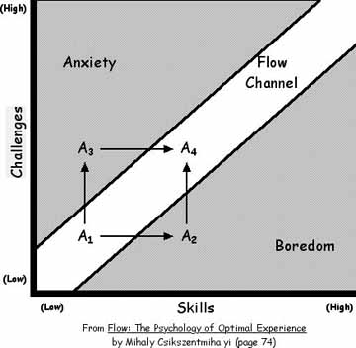
What does ‘ready to learn’ look like?
Challenge level equals skill level
Perceived challenge equals skills level
Effort vs Reward judgements
Choice in activity at levels.
This is what we want to achieve

Slide 3
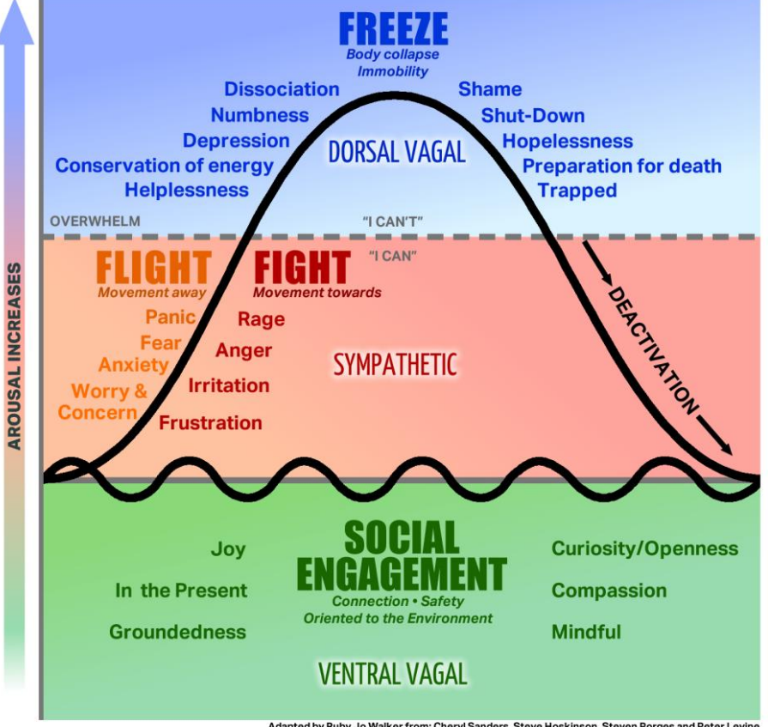
What does ‘ready to learn’ FEEL like?
This is what we sometimes start without!
Engaged
Resilience
Perception of control
Perception of choice
Perception of failure / Risk

Slide 4
Perception:
Perception of control, choice, failure, risk, challenge etc
All items identified as part of ‘ready to learn’, require perception of that area.
Many SEN⁺ students demonstrate impaired interoceptive and exteroceptive perceptions, and therefore may not respond as expected to novel transitions (aka the ‘hook’)
Fish perceives hook as getting food
Human perceives hook as being food

Slide 5
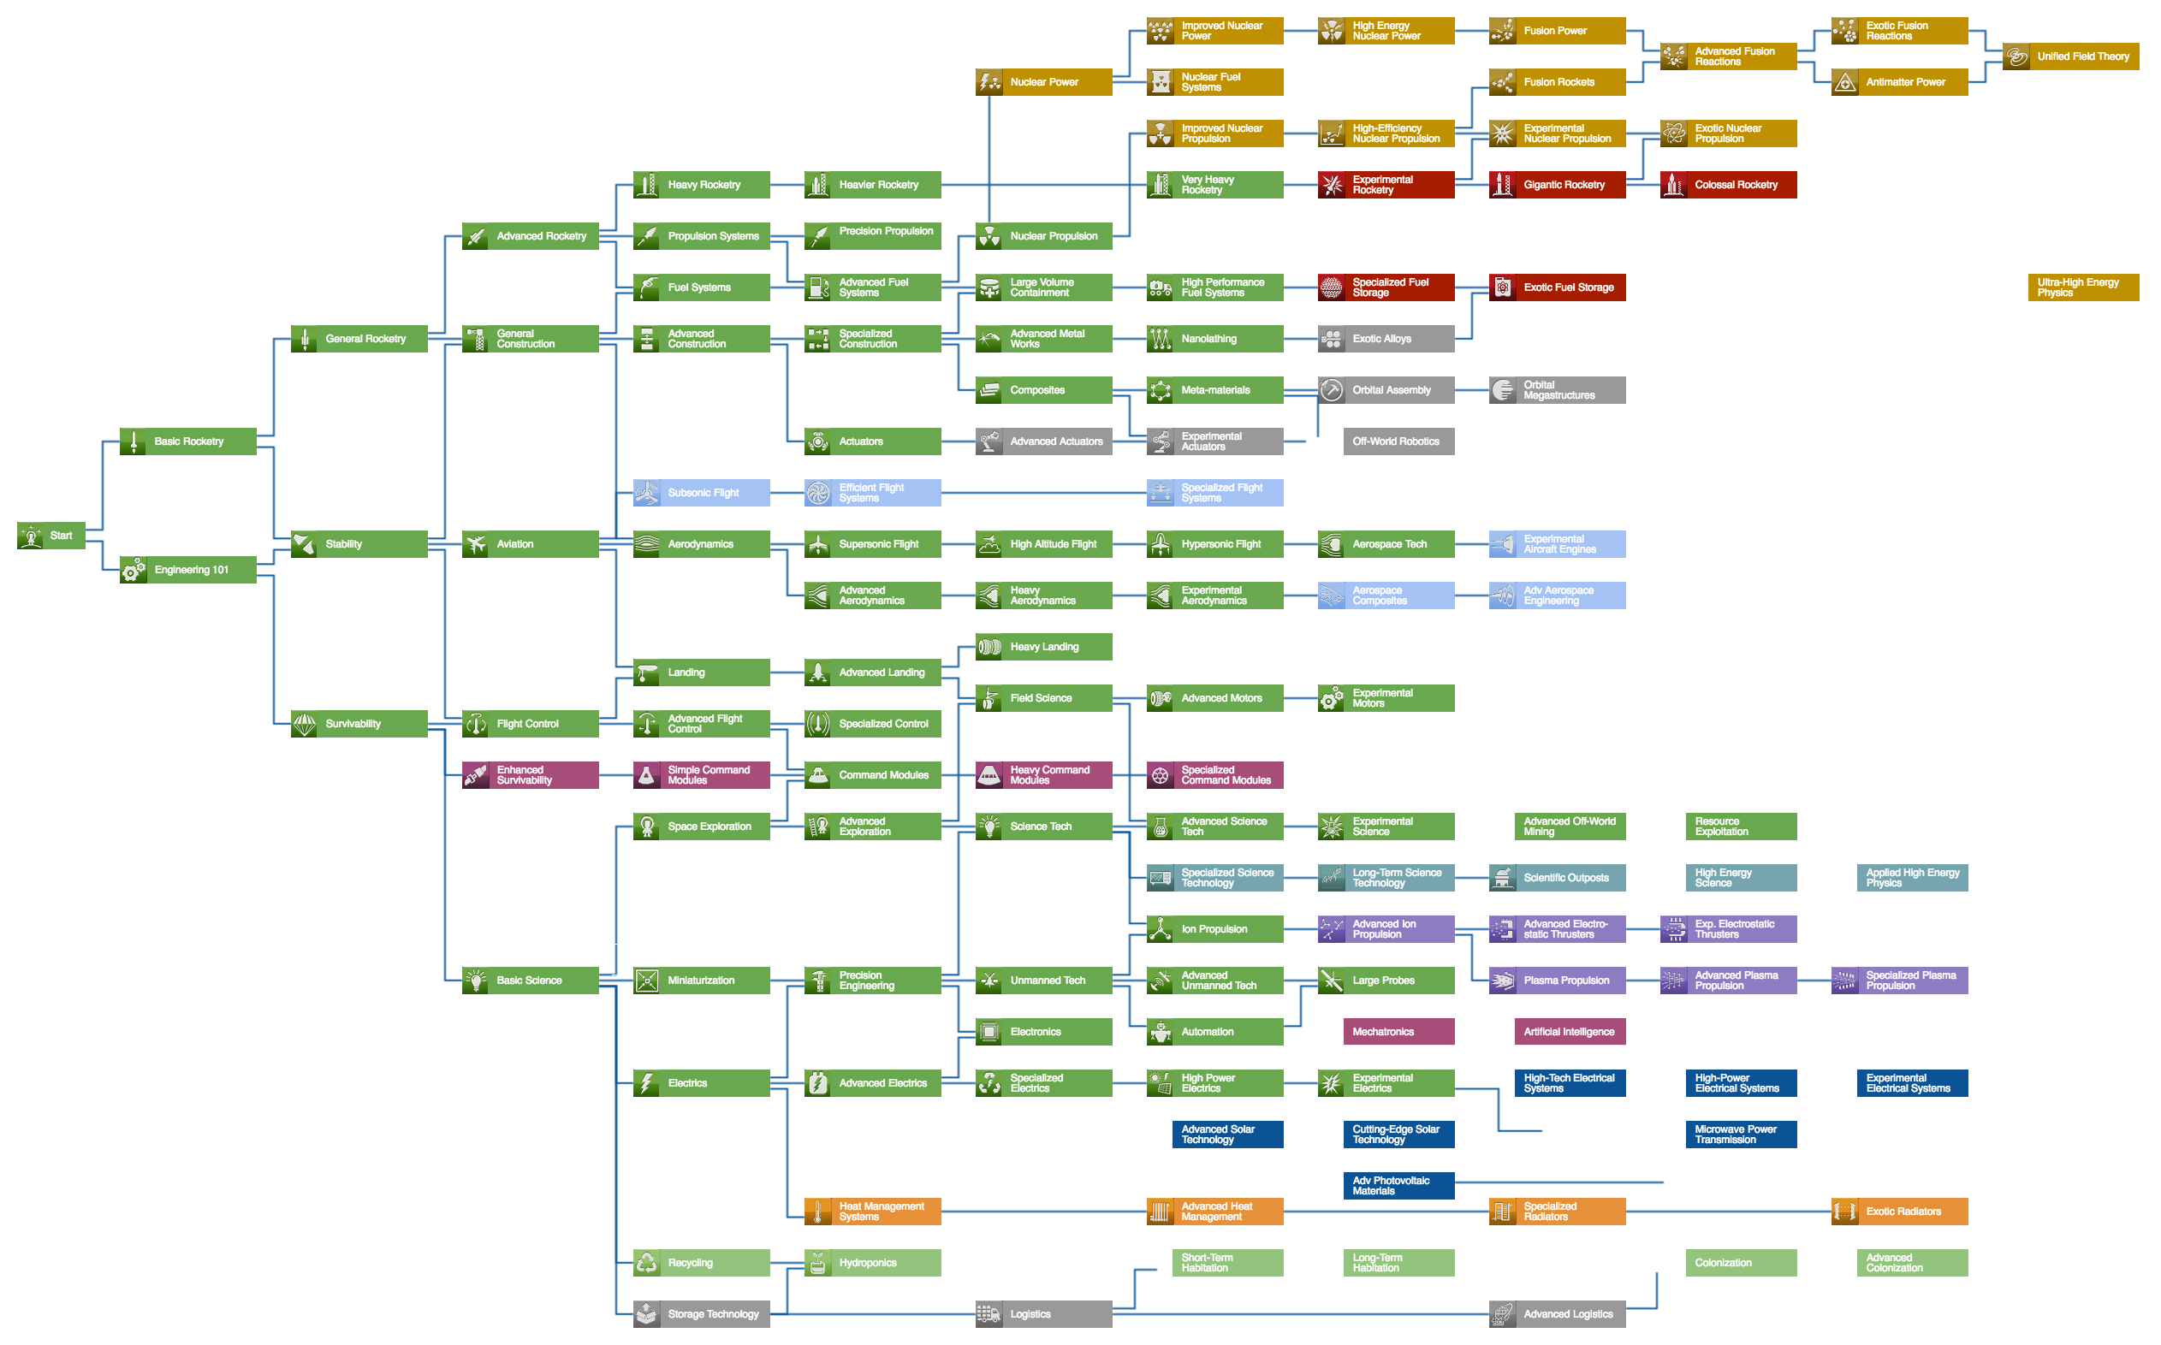
Perception:
Perception of control, choice, failure, risk, challenge etc
All items identified as part of ‘ready to learn’, require perception of that area.
Many SEN⁺ students demonstrate impaired interoceptive and exteroceptive perceptions, and therefore may not respond as expected to novel transitions (aka the ‘hook’)
Some ways to increase perception of transitional states:
Communication: visual, audio, object-orientated (pencil case) or routine orientated (break / ‘later’ box)
Expectation management: The same skill the same way (Aka: Pack up messy to clean, or starter booklet)
Direct Transition Skill demonstration
(Aka tech tree or ‘level up’)
Explicit Explanations: Lived experts in ourselves – students are the same!
Flannery, K. & Horner, R. (1994). The relationship between predictability and problem behavior for students with severe disabilities. Journal of Behavioral Education, 4, 157-176.

Slide 6
Perception:
Communication: visual, audio, object-orientated (pencil case) or routine orientated (break / ‘later’ box)
If → Then
When → Then
Acknowledge Emotions
Establishing Causal Links with specialist areas
Monitor & Cue
(I will help you, after you… read the question to me, underline etc)
Braindump Starter
[very effective for de-escalation]

Slide 7
Perception:
Expectation management: The same skill the same way (Aka: Pack up messy to clean, or starter booklet)
Starter activity in similar formats (on board, on sheet, in booklet)
Picture of equipment printed on the bottom of trays so they go back neatly
Meet & Greet, End & Send (yes it’s cheesy but basically start the lesson on your terms, and end on your terms)
I do, we do, you do.
(model outcome at start)
Mistake ID, identifying mistakes as a positive.

Slide 8
Perception:
Expectation management: The same skill the same way (Aka: Pack up messy to clean, or starter booklet)
Direct Transition Skill demonstration
(Aka tech tree or ‘level up’)
We are learning to …
So we can…
Model work (good example or bad example)
Plan for bad:
How would we work unsafely?
How would we make our writing boring?
Students can plan what not to do as well as what to do.
Schema if available can be quickly turned to a ‘level / tech tree’

Slide 9
Perception:
Explicit Explanations: Lived experts in ourselves – students are the same!
Expectation management: The same skill the same way (Aka: Pack up messy to clean, or starter booklet)
Direct Transition Skill demonstration
(Aka tech tree or ‘level up’)
Routines trump excitement every time
‘Open’ rubrics – how do we know we’ve achieved?
Retrieval activities: A Booklet is amazing for this!
Visual and Captioned targets can work well
Short term → Long term reflection

Slide 10
Developing transitions
@GregRixASC
www.gregrix.uk
Greg Rix Bsc (Hons), Natural Sciences (Open); PGCertEd, Physics and Mathmatics; QTS; MCCT; MCybS; PGCert (Autism)

